Slide 1


RECOMMENDER SYSTEM FOR ONLINE SHOPPING
TEAM 27 : -
SUBJECT: -
Jayshil Patel
Josh patel
Pratik Gade
Hrutik Champaneri
Data Science Applications
Prof. Arya Rahgozar

Slide 2
Presentation Flow
DATA
Choosing data
Data Cleaning
Analysis
ML
Collaborative Filtering
Observations
Algorithms
Error Analysis

Slide 3

The Dataset
CHOSEN DATASET
Data of things bought on ‘Amazon.com’
Multiple important columns : -
Product name
Product ID
Actual Price
Discounted Price
Ratings
Not too messy – Not too Clean
EVERYTHING DEPENDS ON DATA

Slide 4
The Dataset
DATA CLEANING
Changing Data Types of Columns from object to Floats
Filling in Missing Information
Checking For Duplicate Rows
Splitting Long Strings
Splitting data in categorical manner
Creating New Columns
rating_score
price_difference
EVERYTHING DEPENDS ON DATA

Slide 5
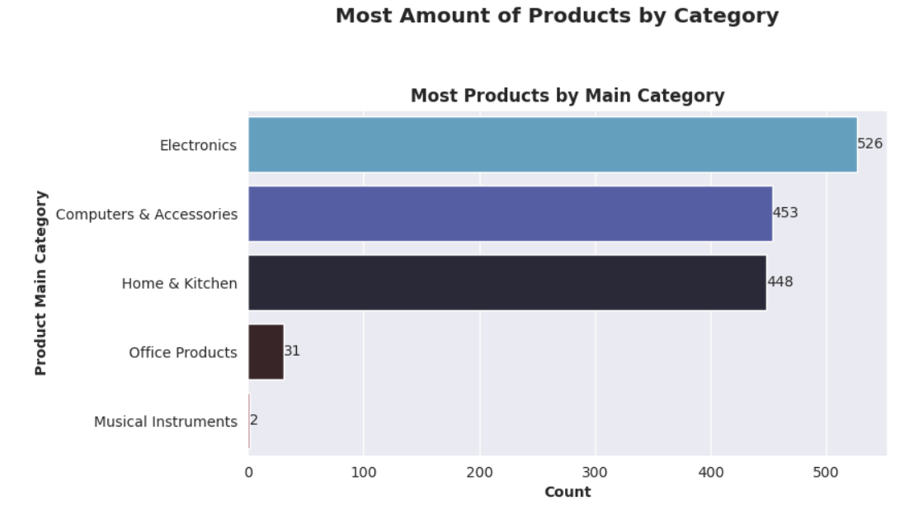
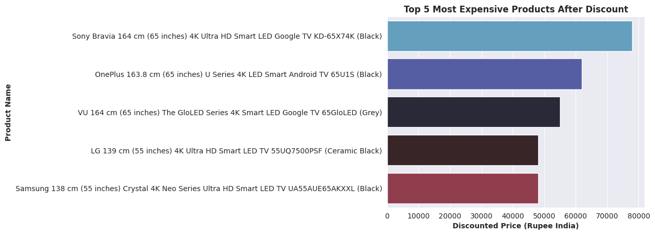
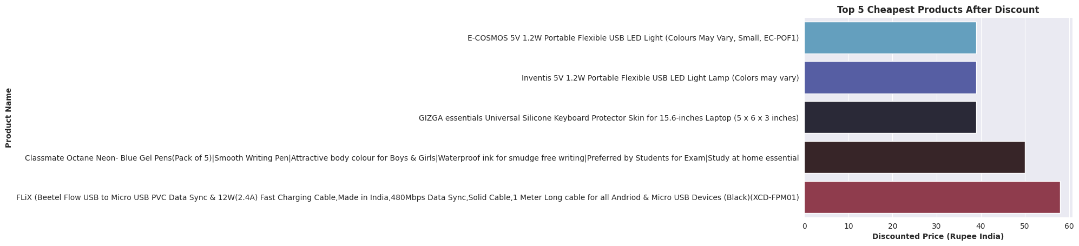
Product-category
EXPENSIVE - CHEAPEST
Computers & Accessories
Home and Kitchen
Electronics

Slide 6
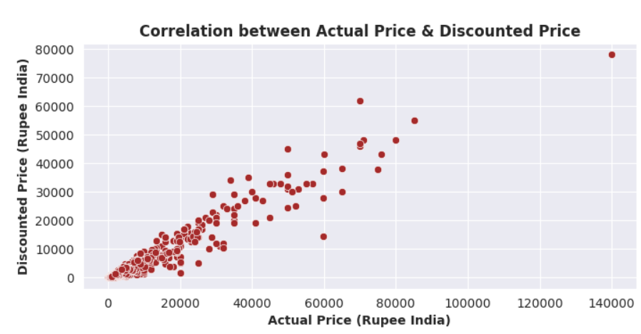
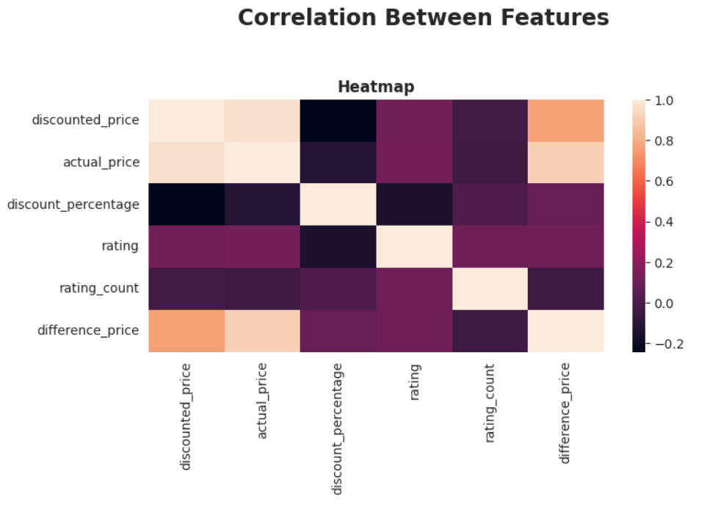
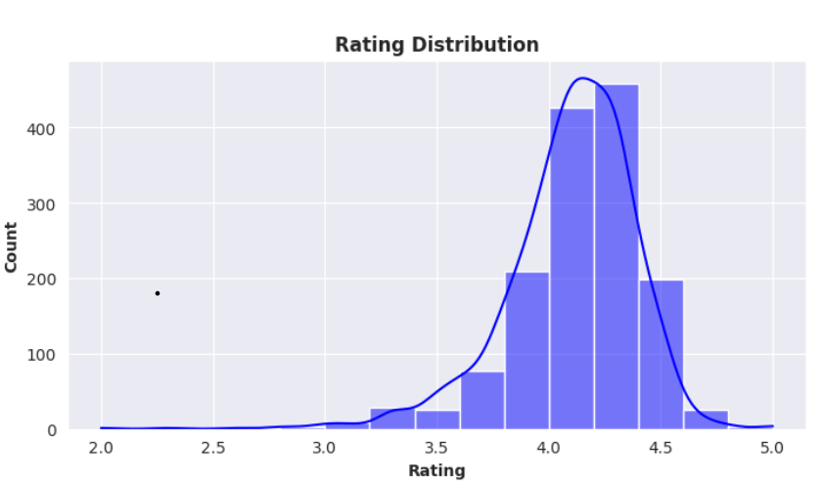
HEATMAP
RATING DISTRIBUTUION
From the image below, it is very clear that there is almost no correlation between features.
Most of the product rating range around 4.0 - 4.375 with no products under the score of 2.0. The rating distribution in slightly left-skewed.
Only the actual prices of products and the discounted prices of products have a positive correlation.

Slide 7
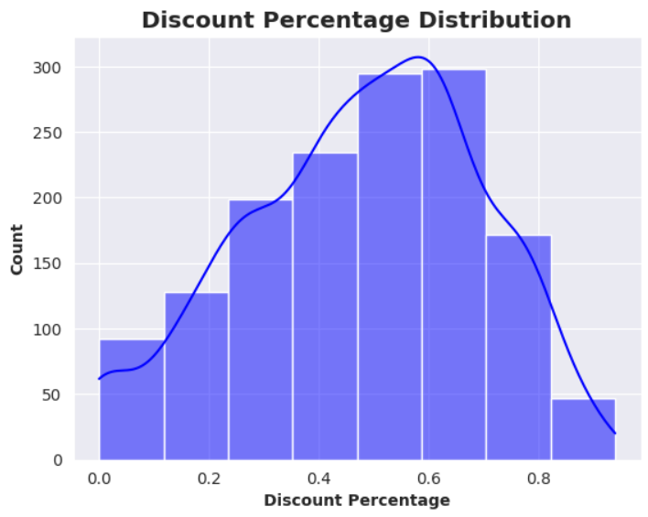
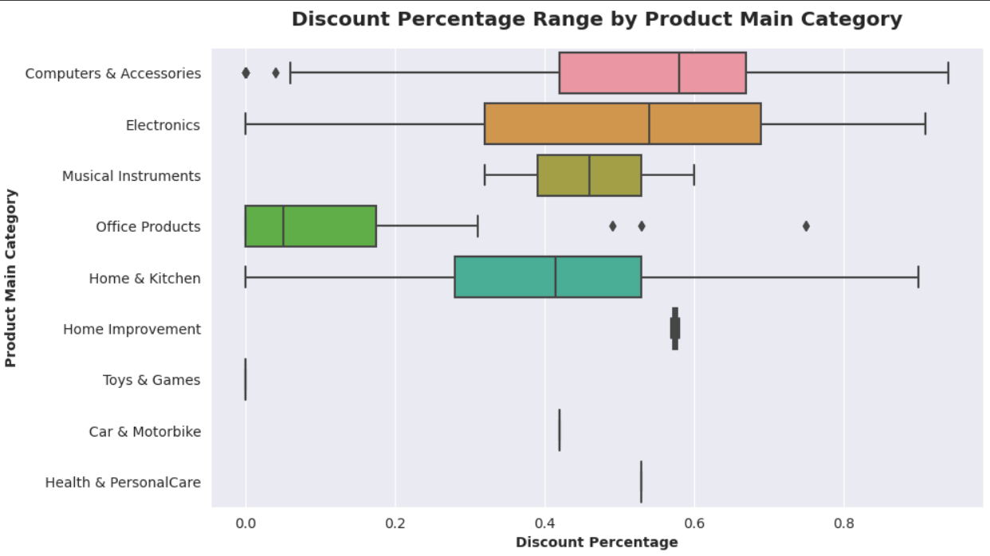
DISCOUNT DISTRIBUTION

Slide 8
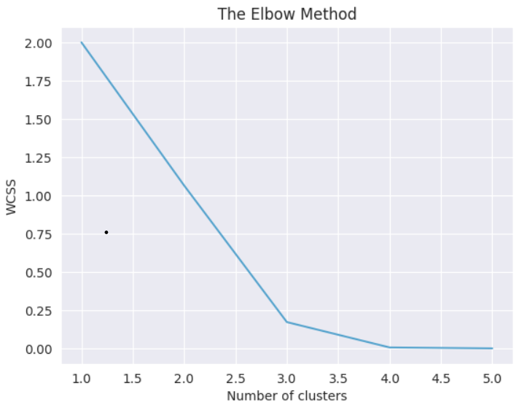
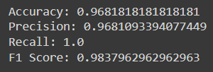


ALGORITHMS
K MEANS Clustering
Random Forest Classifier
Support Vector Classifier
Logistic Regression
Random forest classifier
Support Vector Classifier
Logistic Regression

Slide 9
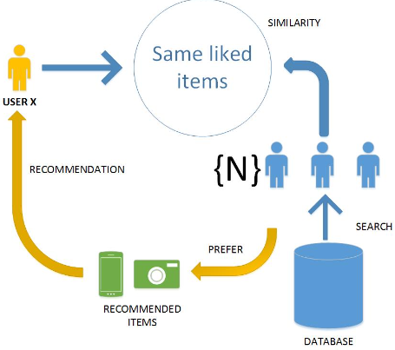
COLLABORATIVE FILTERING
First step is to filter according to the rating given to products.
Second is to filter according to product name and description.
Rating wise DF
Decomposing the Matrix
Recommended Products
Feeding previous bought product
Correlation matrix

Slide 10
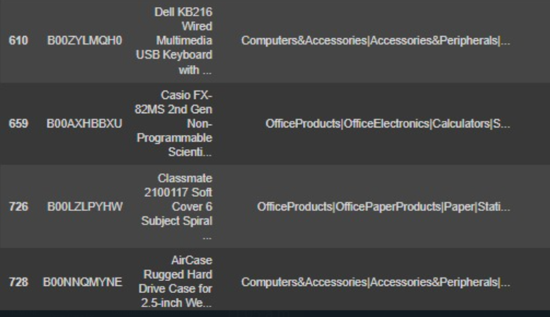
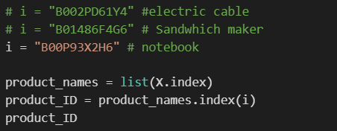
ERROR ANALYSIS
A few products get mismatched
Due to similar words in description and similar ratings

Slide 11
THANK YOU

